Slide 1
Grant Opportunities The New Community Grants at The Community Foundation for McHenry County

Slide 2
Get Thinking…
Which opportunity best fits the needs of your organization?

Slide 3
Connecting People Who Care With Causes That Matter.

Slide 4
The New Community Grants
A single annual cycle with two different opportunities:
Transformational
Grants
Mission
Grants

Slide 5
Transformational Grants

Slide 6
Transformational Grants
Designed to support a charitable organization through the expansion of an idea or assist with a work in progress that will lead to organizational advancement.

Slide 7
Transformational Grants
Relies on Collaboration
Involves Breakthroughs
Is About “Being the Change”
Accentuates the Positive
Balances Control and Letting Go
Is Holistic
Happens at All Levels
Engages the Heart
Transformational Change:
Source: Gass, Robert. (2010). What is Transformational Change?

Slide 8
Transformational Grants
Up to $75,000 per year.
Maximum of three Transformational Grants awarded per year.
Organizations must apply annually.
Eligible to apply up to three years in a row.
May only submit one application per year.
May use up to 25% on general operating costs related to program.
Potential to receive a total of $225,000.

Slide 9
Transformational Grants
Responsibilities:
Application:
Letter of Intent, Site Visit, Full Application (By Invitation Only), Logic Model, Board Presentation.
Reporting:
Mid-term and Final Report, 2-3 Site Visits.
Publicity:
Sharing Stories of Impact with The Community Foundation and McHenry County Community.

Slide 10
Transformational Grants 2020-2021 Timeline
January 15: Grant Process Begins, RFP available
January 15 and 21: Grant Workshops
February 12: Letter of Intent Due
February 19–24: Site Visits
February 26: Invitations for Full Proposal
March 4 and 10: Workshop on Logic Models
April 1: Full Application Due
April 21: Finalists Presentations
April 24: Grant Recipients Notified
May: Grant Distribution

Slide 11
Mission Grants

Slide 12
Mission Grants
Designed to support charitable organizations providing community resources to McHenry County by funding new and current projects or general operating costs.

Slide 13
Mission Grants
Up to $25,000 per year.
Number of available grants based on funds available.
Organizations must apply annually.
Eligible to apply up to three years in a row.
May submit one application per year.
Potential to receive a total of $75,000.

Slide 14
Mission Grants Application Options
Program Application
To support a new or existing program.
May use up to 25% on general operating costs related to program.
General Operating Application
To support organization’s general operating needs.

Slide 15
Mission Grants
Responsibilities:
Application:
Full Application.
Reporting:
Mid-term and Final Report, 1 Site Visit.
Publicity:
Sharing Stories of Impact with The Community Foundation and McHenry County Community.

Slide 16
Mission Grants 2020-2021 Timeline
May 6: Grant Process Begins, RFP available
May 6 and 12: Grant Workshops
June 2 and 3: Brown Bag Review Sessions
June 19: Full Application Due
July 24: Grant Recipients Notified
August: Grant Award Celebration and Distribution

Slide 17
Don’t worry. I’m here for you.

Slide 18
Important Details
An organization may only be awarded one grant per year.
If an organization applies for a Transformational Grant and is not selected, they are eligible to apply for a Mission Grant within the same grant cycle.

Slide 19
Explain that better, Kelsey.
Was your organization AWARDED a Transformational Grant this year?
YES: You CANNOT apply for a Mission Grant this year.
NO: You CAN apply for a Mission Grant this year.

Slide 20
Important Details
Collaboration is key.
Mark your calendar with important dates and workshops.
National Philanthropy Day 2020!
Grant Workshops listed in today’s program and on our website.
Educational opportunities at Volunteer Center McHenry County.
Share your impact.

Slide 21
Impact
OUTPUTS
OUTCOMES
IMPACT
Numbers
Statistics
Context
Answers: “So What?”
Mission Advancement
+
=

Slide 22
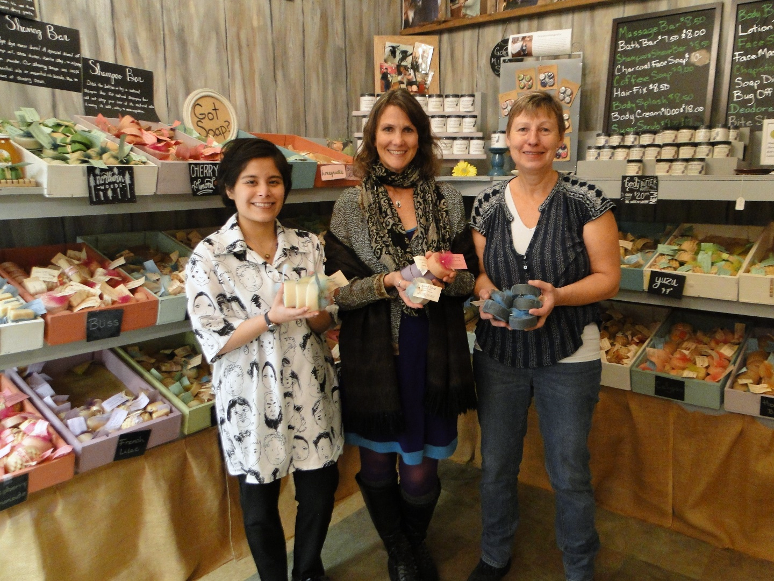
Environmental Defenders of McHenry County
Left to right: Jasmine, Cynthia, and Annette at Silver Prairie Natural Soap Company.

Slide 23
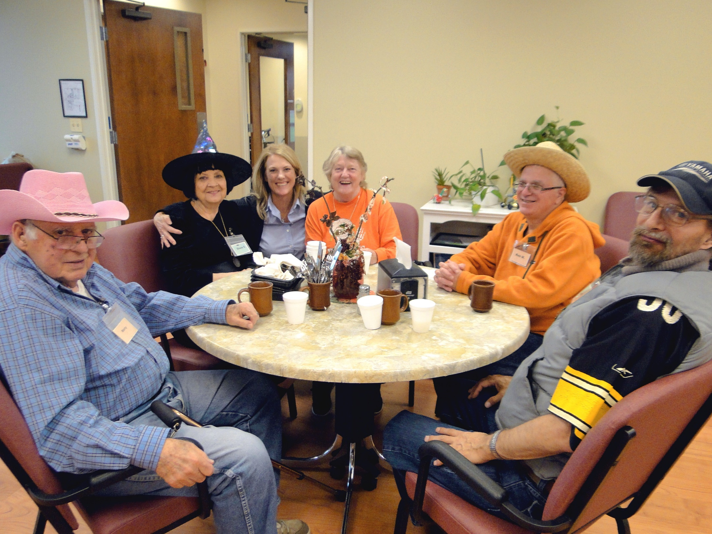
Independence Health & Therapy
Left to right: Marty, Diane, Amy, Judy, Ken, and Lee at Independence Health and Therapy.

Slide 24
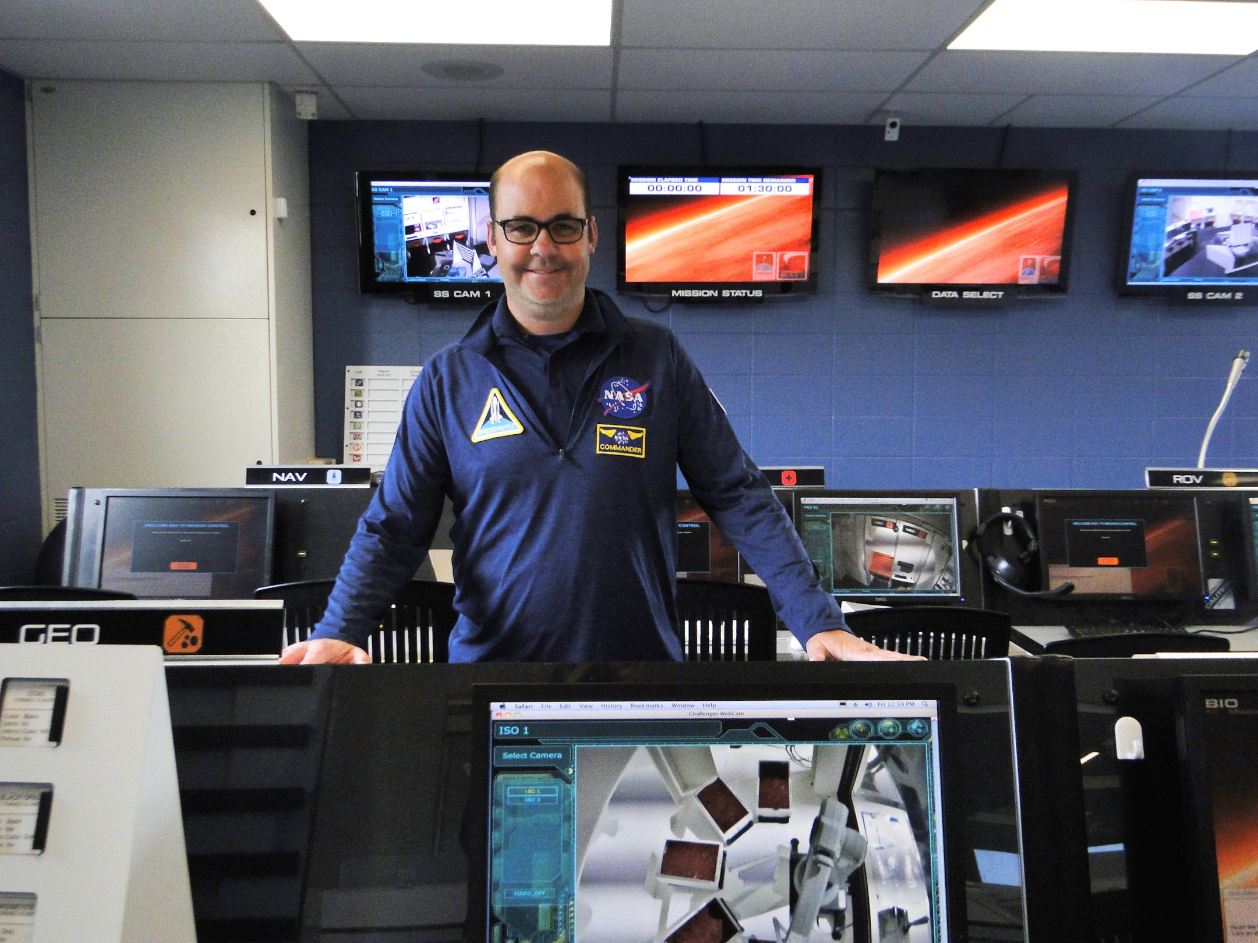
Challenger Learning Center
Tom at The Challenger Learning Center.

Slide 25
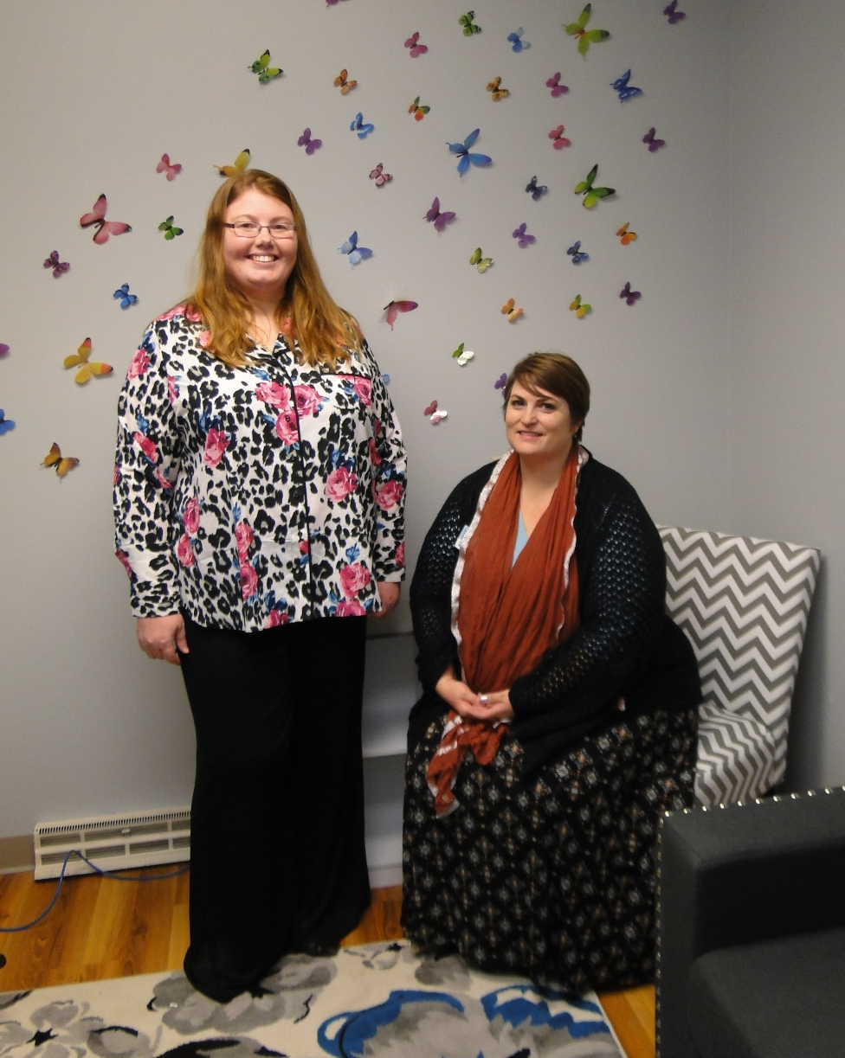
Child and Family Therapy Center Part of Pioneer Center for Human Services
Left to right: Liz and Erin at the new Child and Family Therapy Center.

